Slide 1
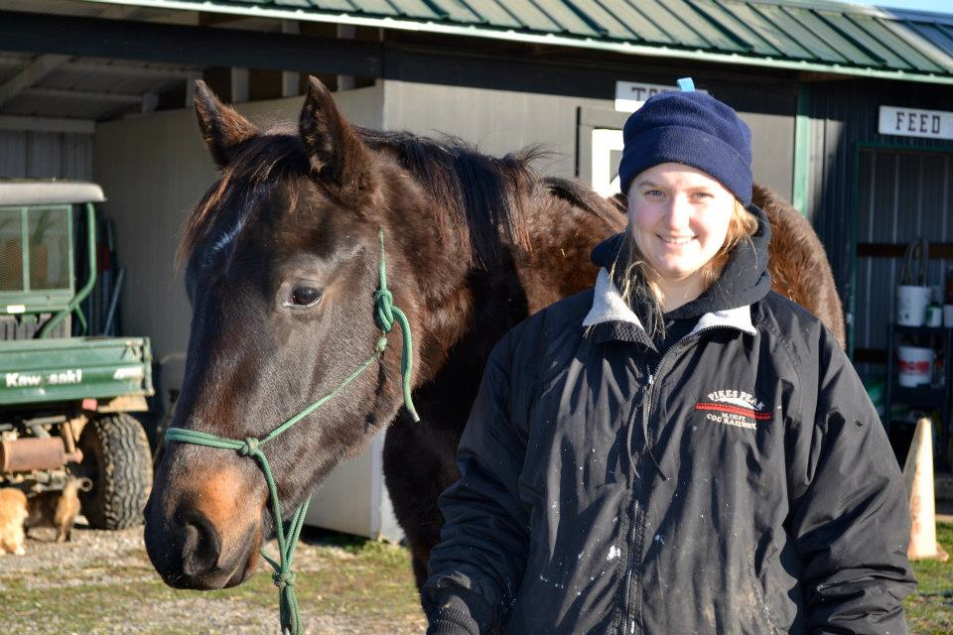
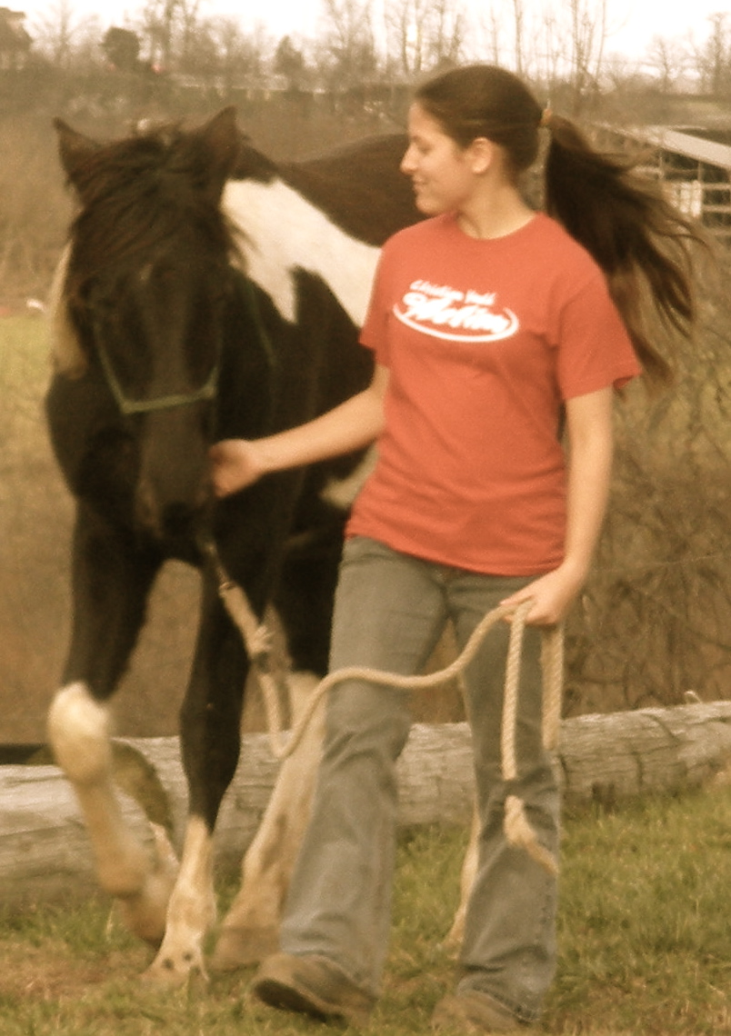
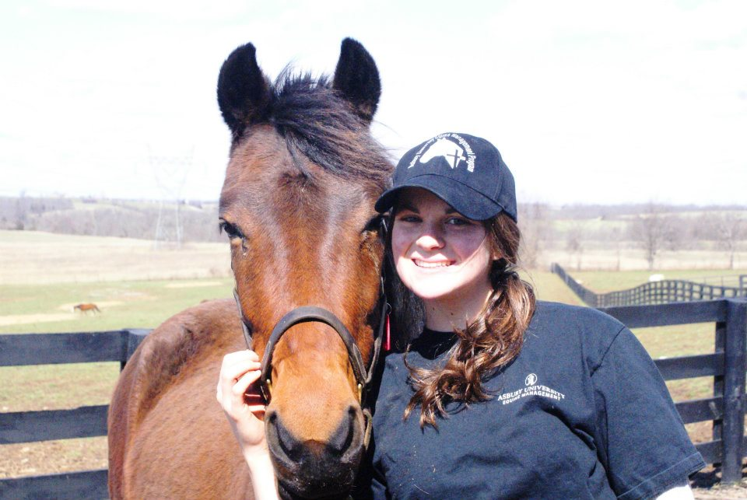
The Effect of Interaction with Horses
on Psychological Well-being
Megan Kuhl Sarah Ritter Johanna Rodig Janet B. Dean, PhD
Control Group
(n = 34)
Assessment 1
Assessment 2
INTRODUCTION
Weekly Horse Interaction Group (n = 15)
Assessment 1
Assessment 2
RESULTS
Stress and Mood
Owning a horse increases positive mood and decreases stress (Koch, 2008)
Participation in 4 ½ days of Equine-Assisted Experiential Therapy leads to a decrease in psychological distress and an increase in psychological well-being after 4 ½ days (Klontz, 2007)
Self-Efficacy
Interviews with 5 abused women show equine-facilitated psychotherapy helps women feel like they had power to direct their own lives (Meinersmann, 2008)
Equine-rehabilitation and onotherapy (donkeys) improved autonomy for intellectually challenged adults (Borioni et al., 2012)
Short-Comings in Published Research
Small sample sizes, Non-random sampling, No control groups
Finding #1 – Self-Efficacy – Participants’ general self-efficacy tended to change over the three week period, F (2, 52) = 9.13, p < 0.000 (One-Way ANOVA).
The Weekly Horse Interaction group showed greater change than the Control group, p < 0.001 (LSD).
The Daily Horse Interaction group had scores than the Weekly Horse Interaction group, p < 0.008 (LSD).
Finding #2 – Anxiety – Participants’ anxiety levels tended to decrease over the three week period, F (2, 52) = 3.87, p < 0.027 (One-Way ANOVA).
The Weekly Horse Interaction group showed a sharper decline in depression than did the Control group, p = 0.014 (LSD).
Finding #3 – Mindfulness – The difference between Scores 1 and Scores 2 showed that the mindfulness and attention awareness of participants almost demonstrated a significant change over the three week period (one-way ANOVA).
F (2, 52) = 3.097, p = 0.054.
Finding #4 – Mood & Work Ethic – There were no significant differences.
Daily Horse Interaction Group (n = 6)
Assessment 1
Assessment 2
HYPOTHESES
DISCUSSION
Hypothesis 1: People with more regular interaction with horses will report a greater change in self-efficacy, anxiety, mindfulness, mood, and work ethic.
Hypothesis 2: Participants with previous horse experience will show less change in self-efficacy, anxiety, mindfulness, mood, and work ethic than those with no previous horse experience.
Conclusions
The Weekly Horse Interaction group demonstrated the greatest positive change in general self-efficacy and anxiety.
There were no differences among the groups for mindfulness, mood, and work ethic.
The amount of horse experience did not significantly impact the results.
Limitations
Small experimental group sizes
No random sampling
Short time period between Scores 1 and 2
Only three participants had no previous horse experience
Future Implications
Use larger experimental groups
Add Environmental Awareness assessment
Assess how horses could impact a clinical population
Pretest Posttest
Self-Efficacy
Pretest Posttest
Anxiety
METHOD
Participants (n = 55)
Male: 18.2% (n = 10) Female: 81.8% (n = 45)
Online Assessments Used
General Self-Efficacy Scale (Scholz et al., 2002)
State Trait Anxiety Inventory for Adults (Spielberg, Gorsuch, & Lushene, 1970)
Mindful Attention Awareness Scale (Black, Sussman, Johnson, & Milan)
Positive and Negative Affective Schedule (Watson & Clark, 1994)
Work Ethic Traits Behavior Indicators Inventory (Fox & Grams, 2007)
Procedure
Pre-post assessments with a three-week interval.
Borioni, N., Marinaro, P., Celestini, S. Del Sole, F., Magro, R., Zoppi, D. . . . Bonassi, S. (2012). Effect of equestrian therapy and onotherapy in
physical and psycho-social performances of adults with intellectual disability: A preliminary study of evaluation tools based on the ICF
classification. Disability and Rehabilitation: An International, Multidisciplinary Journal, 34(4), 279-287.
Klontz, B. T. (2007). The effectiveness of equine-assisted experiential therapy: Results of an open clinical trial. Society & Animals: Journal of
Human-Animal studies, 15(3), 257-267.
Koch, L. F. (2008). Equine therapy: What impact does owning or riding a horse have on the emotional well-being of women? (Doctoral
Dissertation).
Meinersmann, K. M. (2008). Equine-facilitated psychotherapy with adult female survivors of abuse. Journal of Psychosocial Nursing and
Mental Health Services, 46(12), 37-42.
Notes:
Set up exercise here.

